Slide 1


My Hobbies

Slide 2
OUTLINE
Introduction
My Hobbies

Slide 3
A HOBBY is a regular activity that is done for enjoyment purpose, typically during one’s leisure time. Hobbies can include collecting theme items, engaging in creative and artistic pursuits, playing sports etc. By continuously indulging in one’s hobbies one can gain substantial skill and knowledge in that area.

Slide 4
My Hobbies
Sports
Philately
Travelling
Listening Music
Watching Movies and Web Series

Slide 5

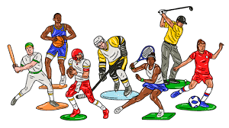
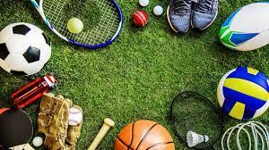
SPORTS
Playing sports helps us to keep rejuvenated.
It helps us to stay fit and healthy.

Slide 6
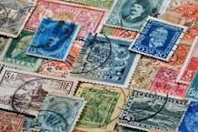
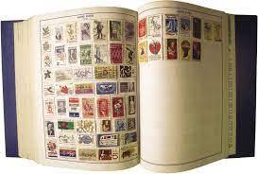
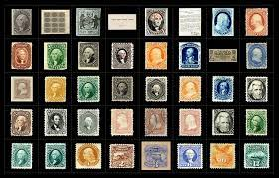
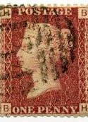
PHILATELY
The collection and study of postage stamps.

Slide 7


TRAVELLING
Travel Makes You Healthier.
Travel Relieves Stress.
Travel Enhances Your Creativity.
Travel Boosts Happiness and Satisfaction.

Slide 8


LISTENING TO MUSIC
It provides a total brain workout. Research has shown that listening to music can reduce anxiety, blood pressure, and pain as well as improve sleep quality, mood, mental alertness, and memory.

Slide 9



Watching movies and web series
Benefits of watching Web series is that you will get to learn and appreciate the different cultures. As a enthusiast, you will watch different series of different actors who originate in different countries.

Slide 10
THANK YOU

